Slide 1

Flight Fare Prediction
BTECH (CSE) 7th semester project
By
Pratyush aanand 1905189
Ashutosh mishra1905600
Sambhav Choudhary 1905634

Slide 2
DESCRIPTION
Using the dataset, we are going analyze and understand the trend and deciding factor on which price of a ticket depend. Then using that knowledge and our understanding of machine learning, we are going to apply regression modelling to train certain model on the dataset so it can predict flight fare. And finally compare the models.

Slide 3
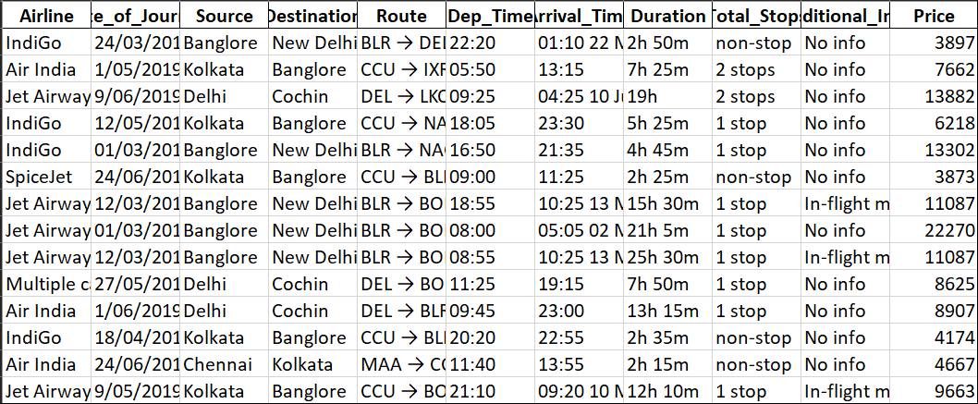
Dataset

Slide 4
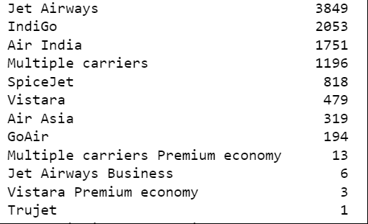
Airline

Slide 5
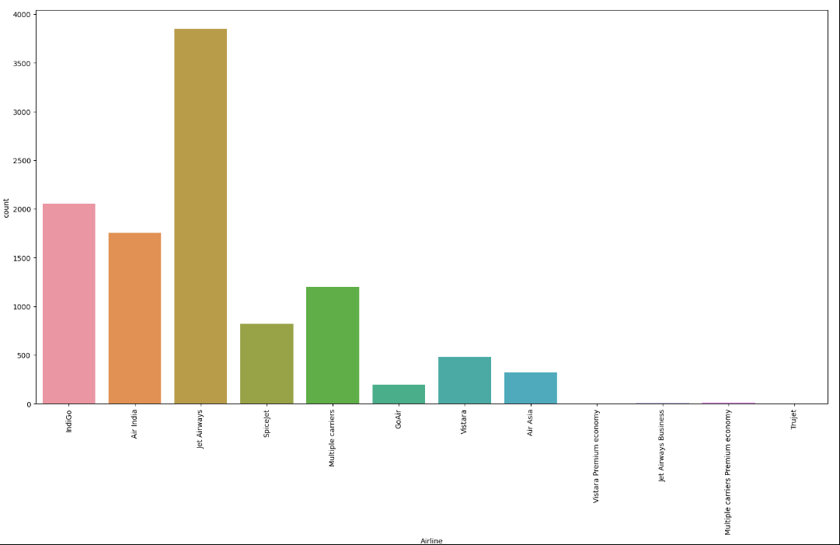

Slide 6
Date of Journey
An object containing date on which the flight was boarded in the format DD/MM/YYYY CE

Slide 7
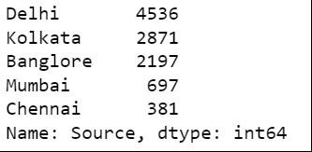
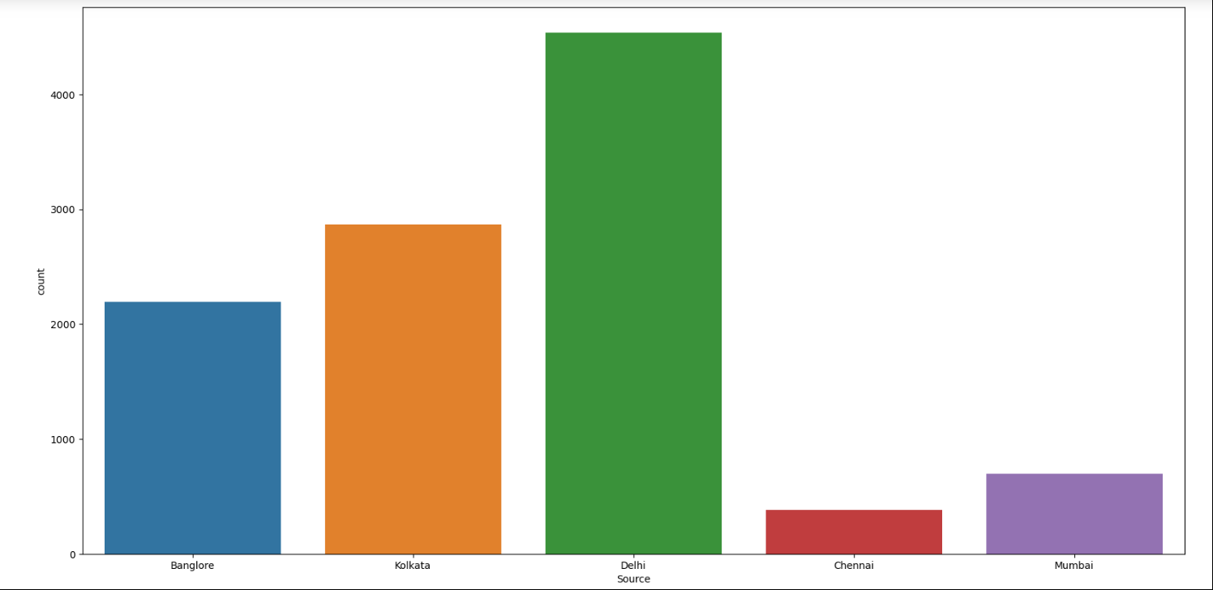
Source

Slide 8
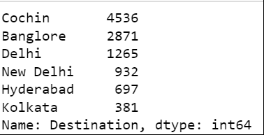
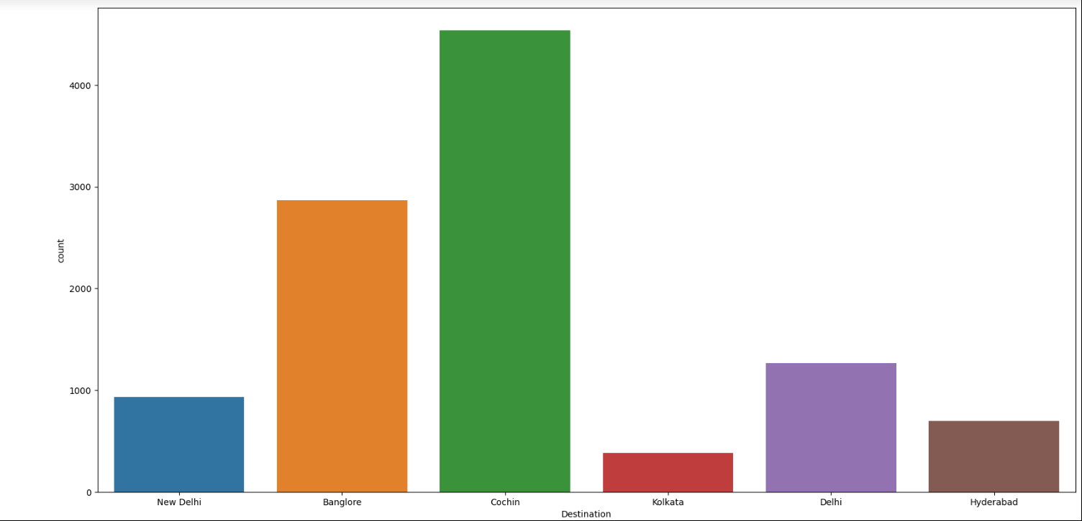
Desitination

Slide 9
ROUTE
Contains detail about the cities travelled by the flight between source and destination
BLR → BOM → DEL

Slide 10
DEP_TIME : Departure time of the flight
Arrival_Time: time when flight reaches destination
Duration : Time Taken by flight between takeoff and landing
Total stops: contains no of stops flight takes before reaching destination

Slide 11
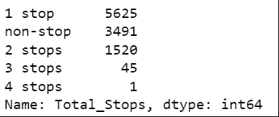
Additional INfo

Slide 12
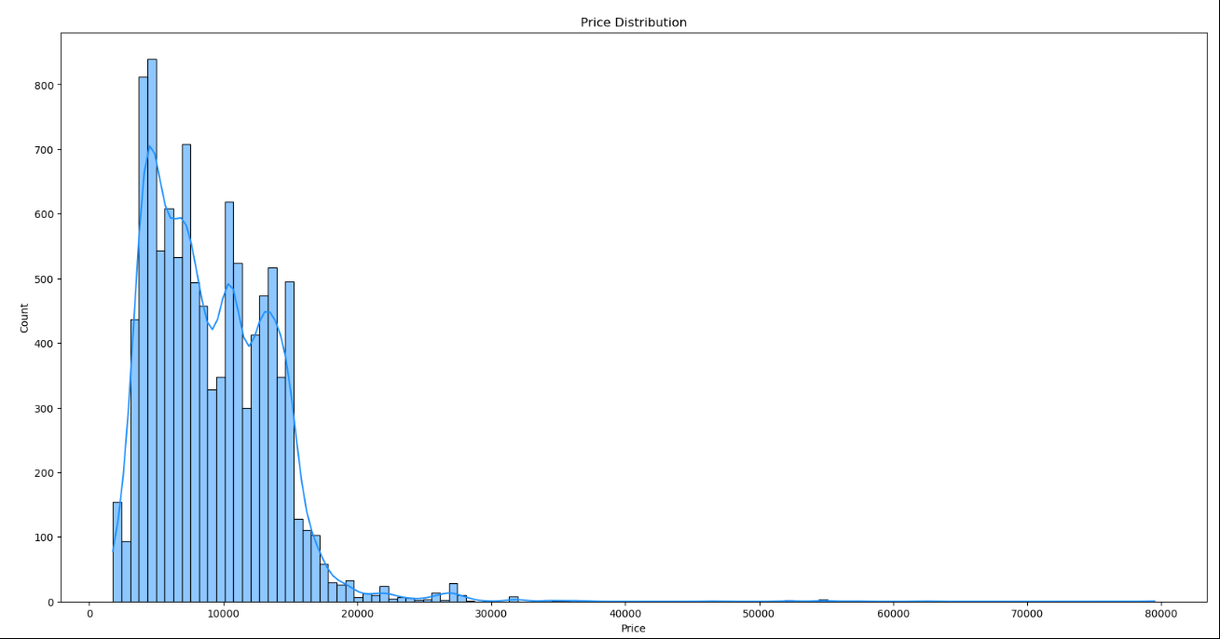
PRICE (DEPENDENT VARIABLE)

Slide 13
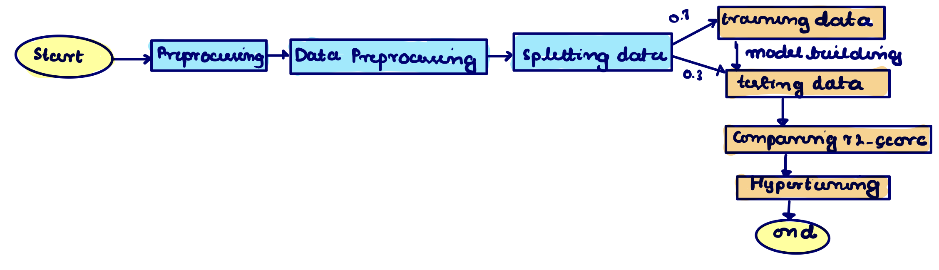
FLOW DIAGRAM

Slide 14
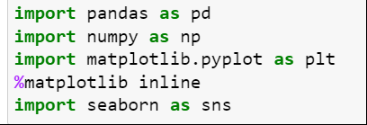
Importing Libraries

Slide 15
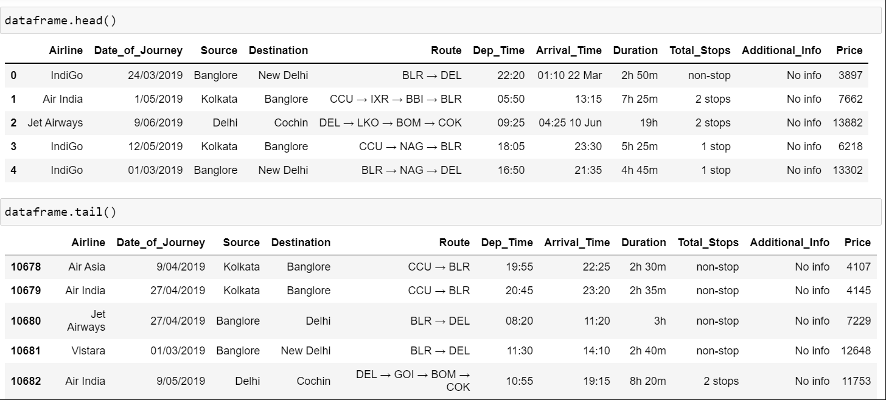
INFO ABOUT DATASET

Slide 16
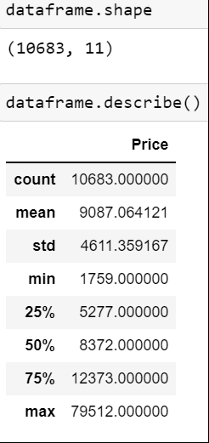
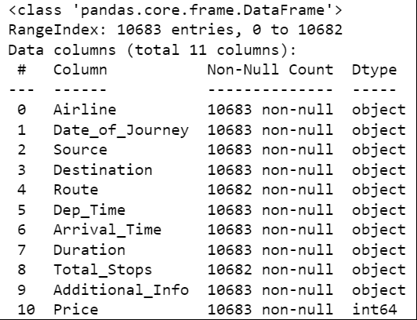

Slide 17
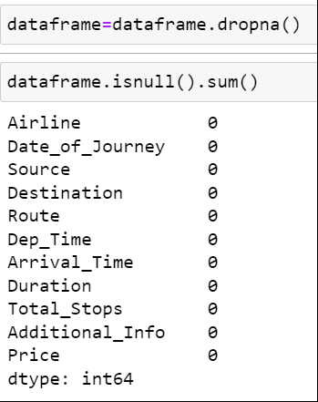
Removing empty cells

Slide 18
PREPROCESSING

Slide 19
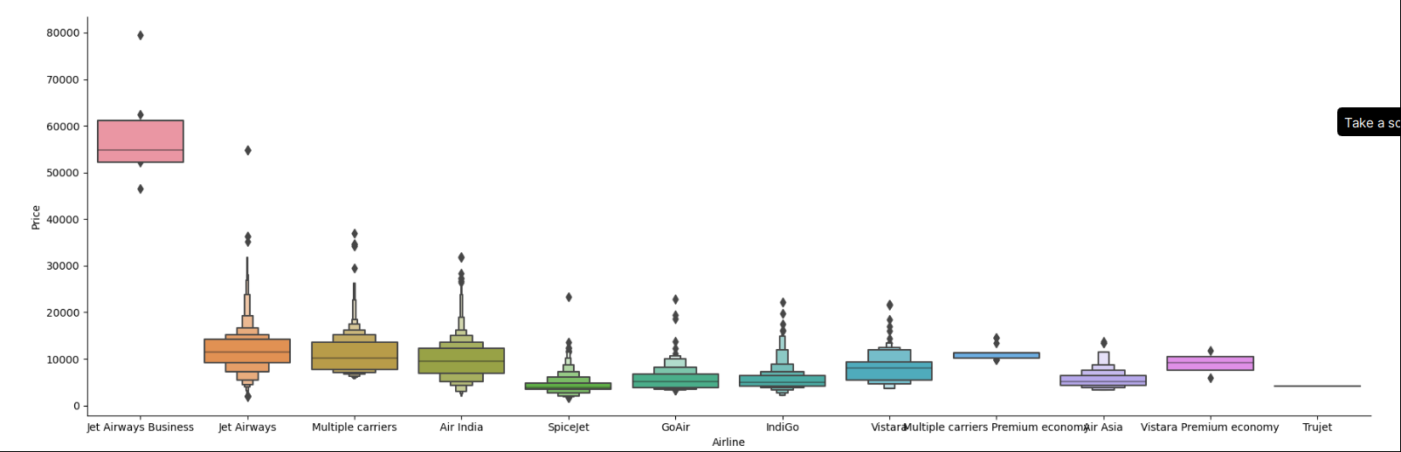
PRICE V AIRLINE

Slide 20
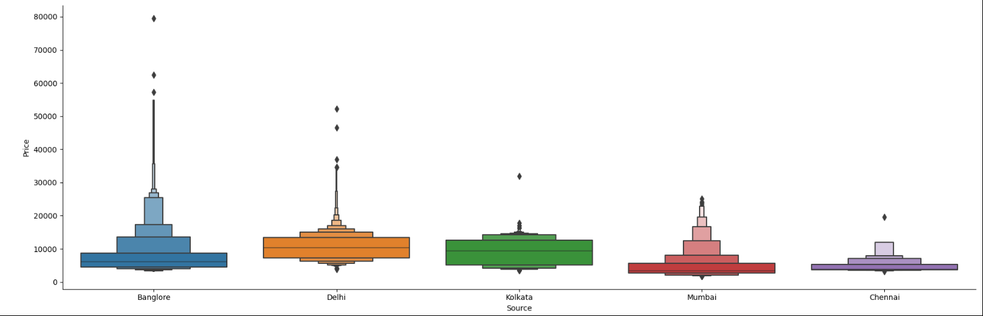
PRICE V SOURCE

Slide 21
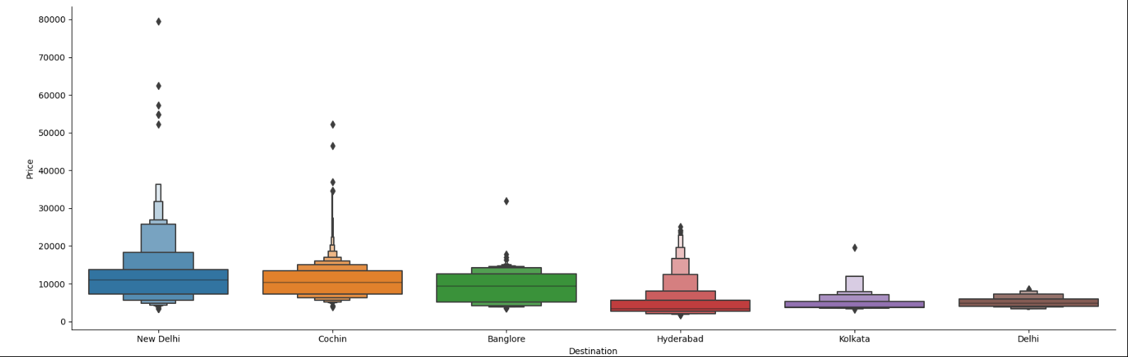
PRICE V DESTINATION

Slide 22
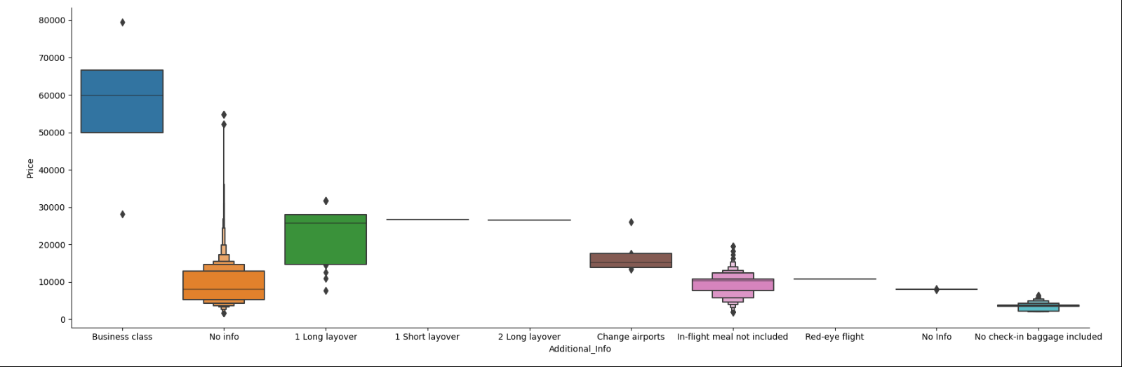
ADDITION INFO V PRICE

Slide 23
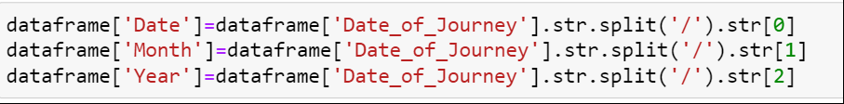
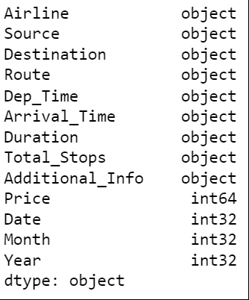
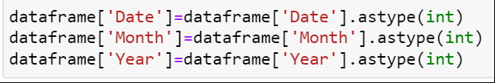
EXTRACTING DATE, MONTH, YEAR

Slide 24
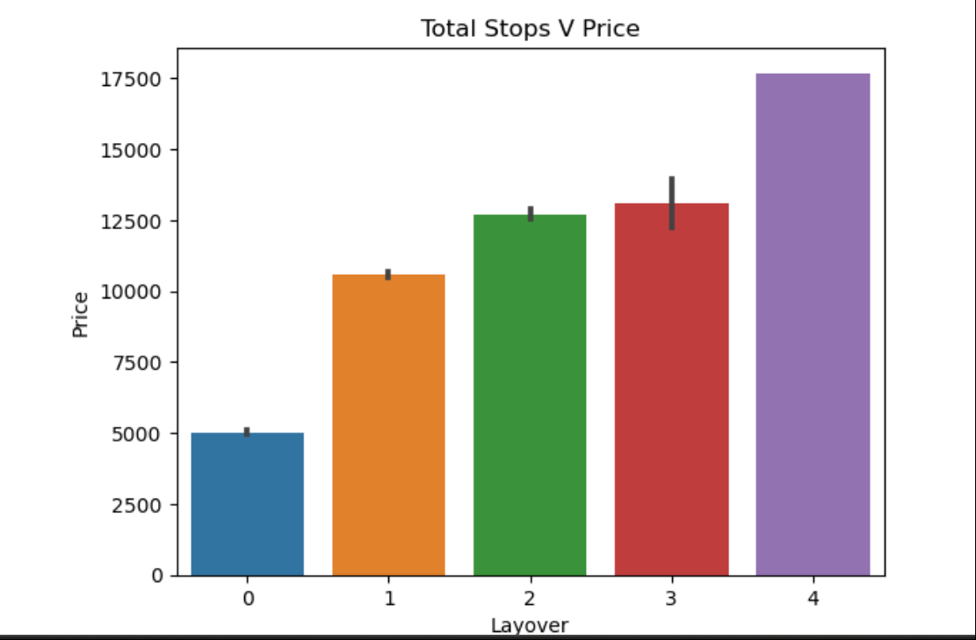
EXTRACTING NUMERIC PART FROM TOTAL STOPS

Slide 25
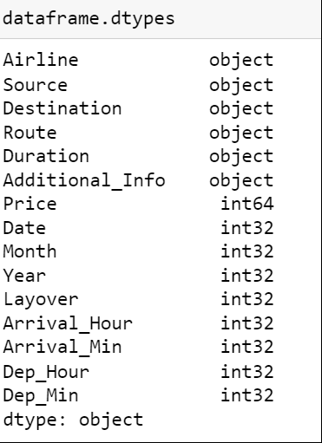

ARRIVAL AND DEPARTURE TIME

Slide 26
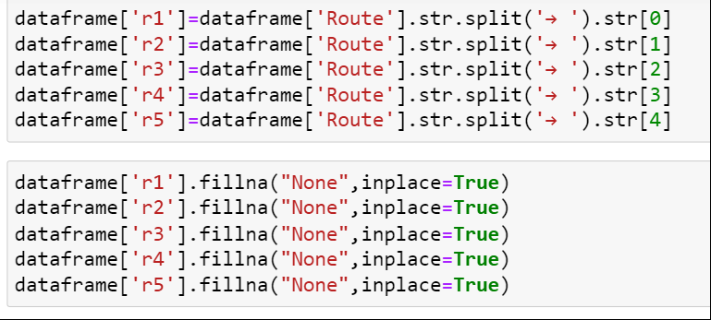
BREAKING ROUTE

Slide 27
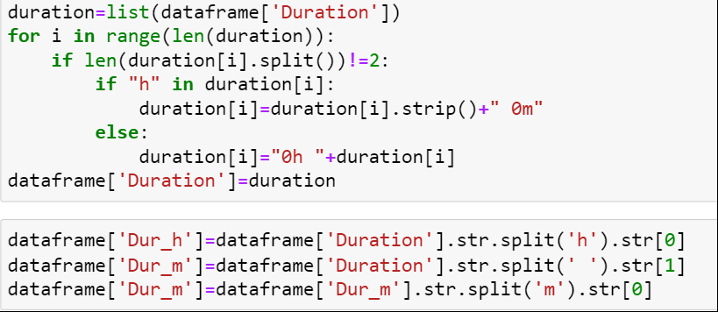

EXTRACTNIG DURATION

Slide 28
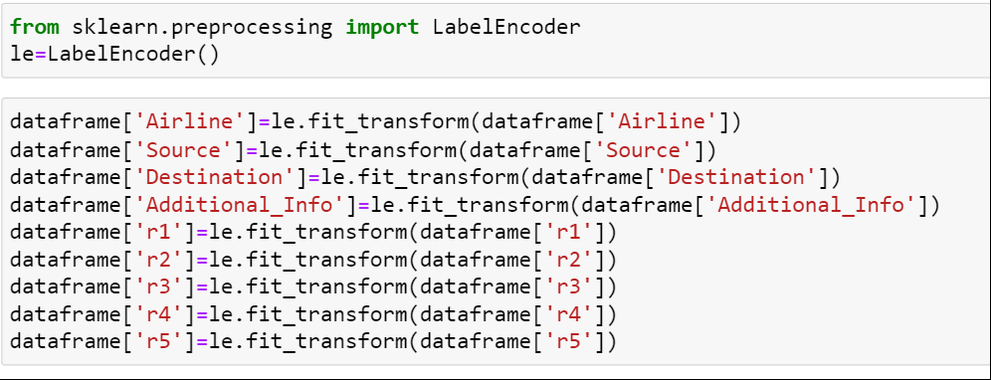
LABEL ENCODING

Slide 29
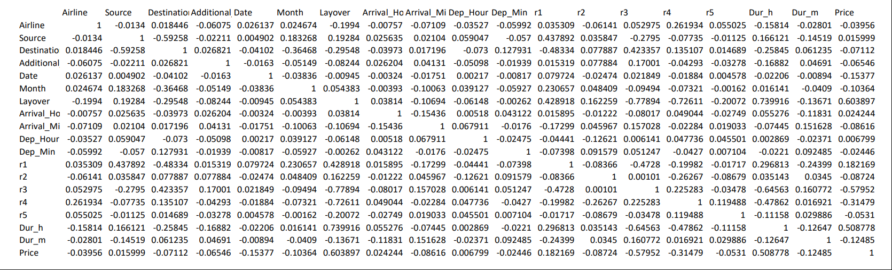
COLLINEARITY

Slide 30
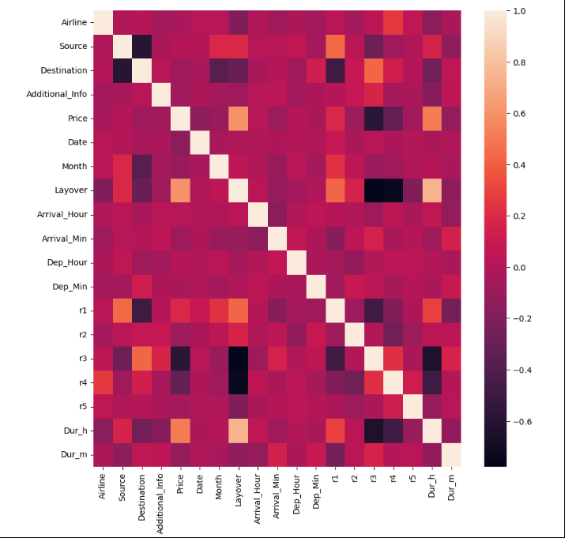
HEATMAP

Slide 31
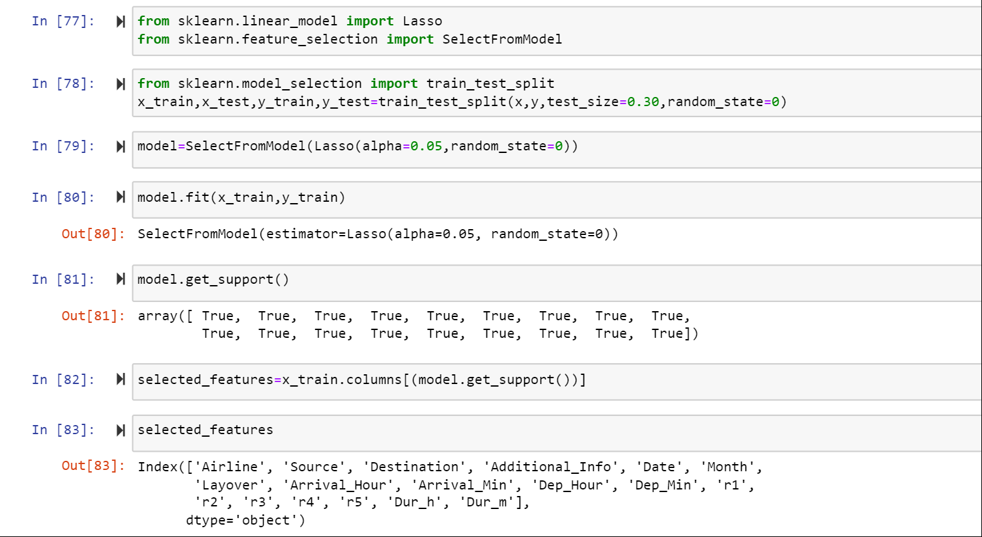
FEATURE SELECTION

Slide 32
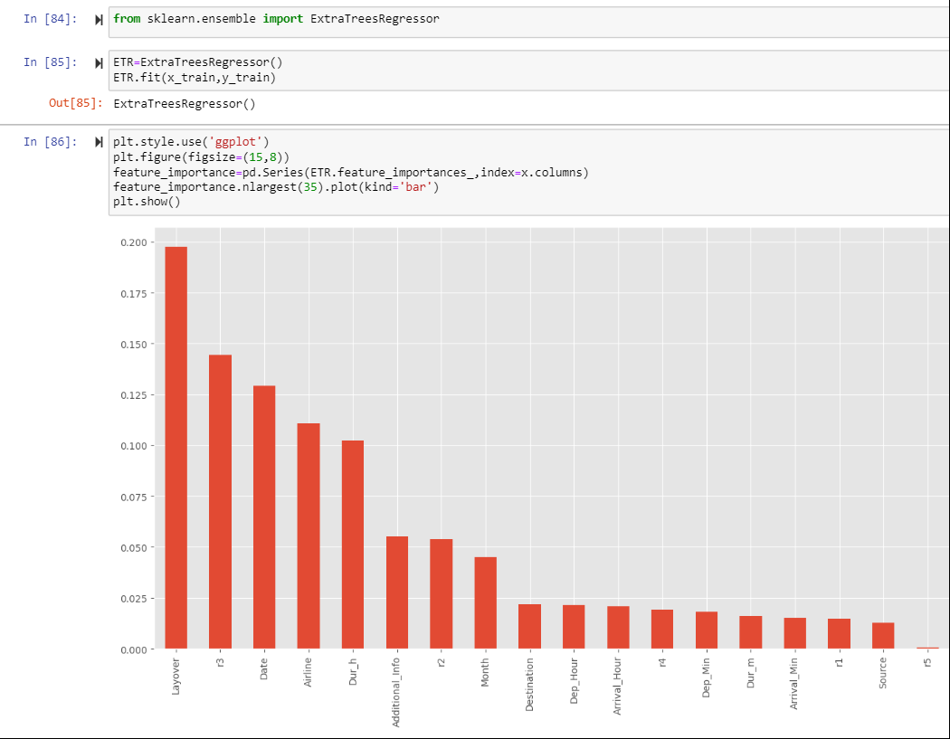
Feature Importance

Slide 33
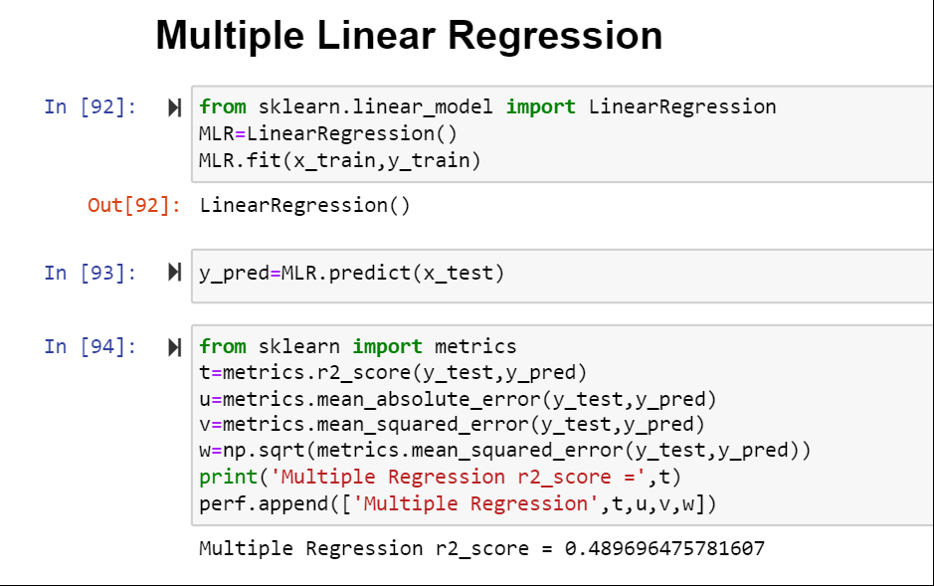

Slide 34
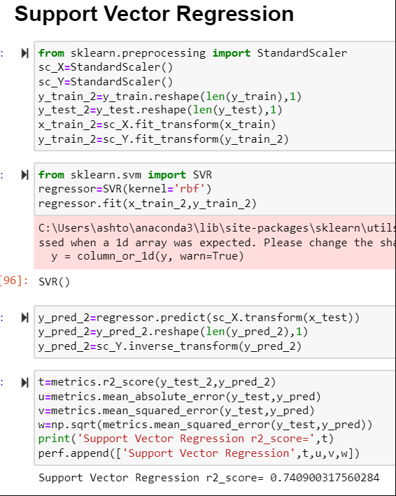
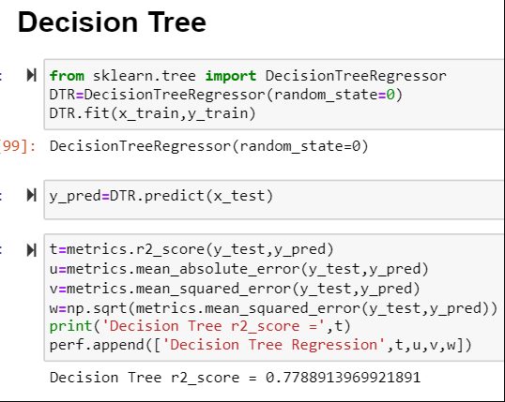

Slide 35
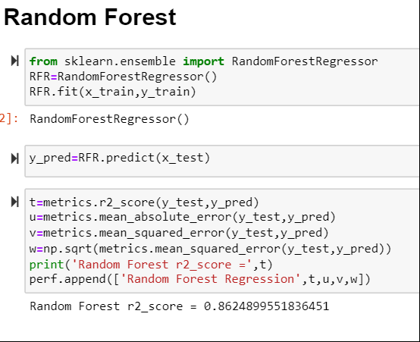

Slide 36
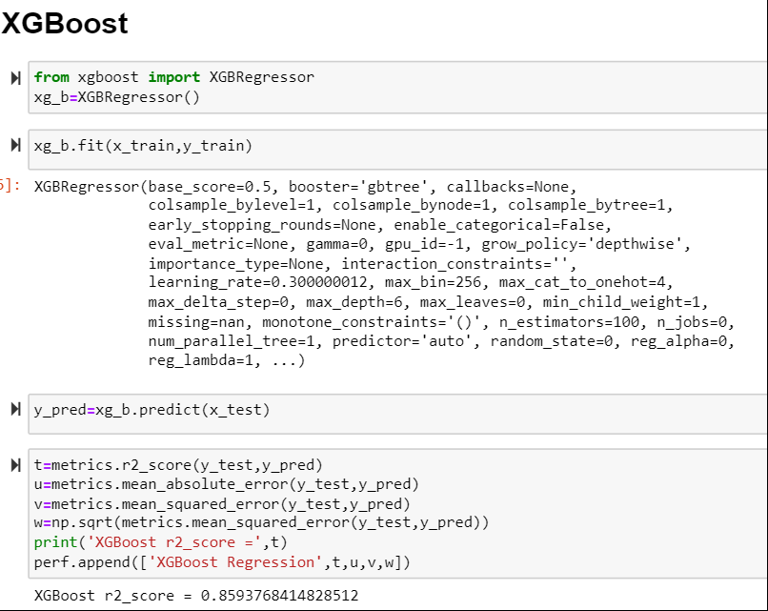

Slide 37
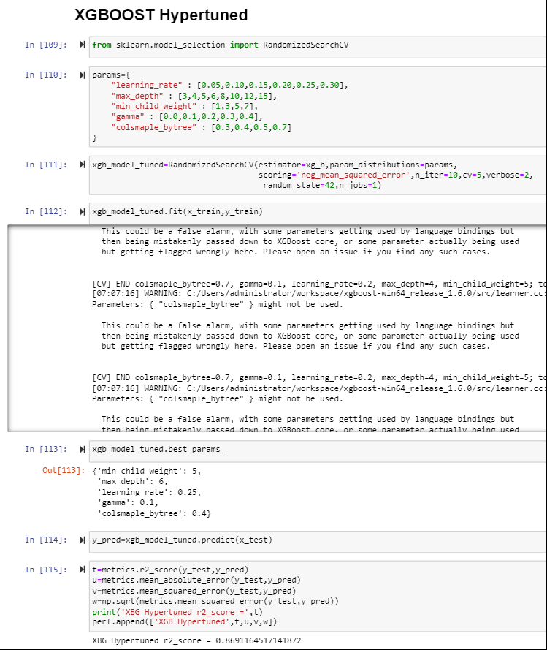
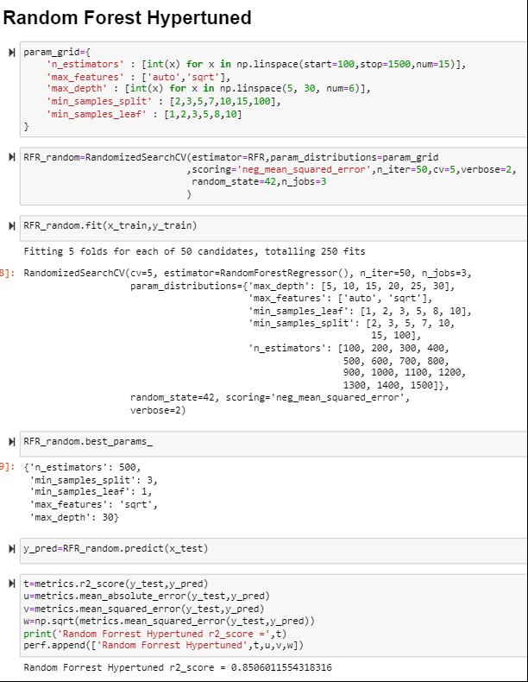

Slide 38
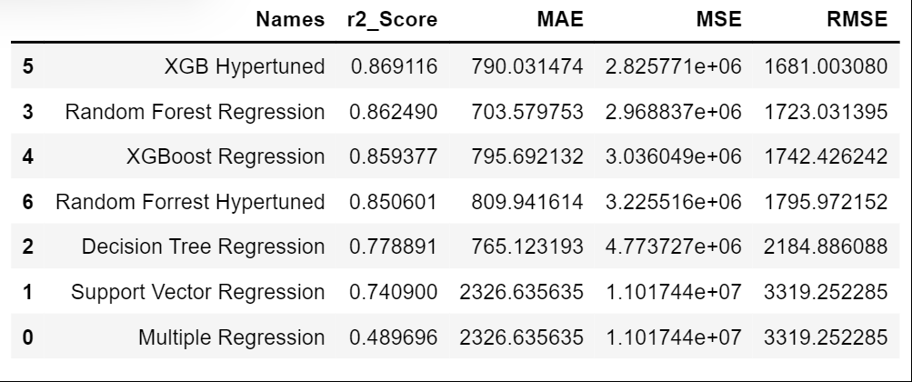
COMPARISION BETWEEN MODELS

Slide 39
REFRENCES
https://www.kaggle.com/datasets/nikhilmittal/flight-fare-prediction-mh
https://www.investopedia.com/terms/r/regression.asp#:~:text=A%20regression%20is%20a%20statistical,more%20of%20the%20explanatory%20variables.
https://docs.python.org/3/
https://towardsdatascience.com/what-and-why-behind-fit-transform-vs-transform-in-scikit-learn-78f915cf96fe
https://www.statisticshowto.com/lasso-regression/
https://www.datatechnotes.com/2021/04/selectfrommodel-feature-selection.html
https://scikit-learn.org/stable/modules/generated/sklearn.ensemble.ExtraTreesRegressor.html#:~:text=An%20extra%2Dtrees%20regressor.,accuracy%20and%20control%20over%2Dfitting.
https://pandas.pydata.org/docs/reference/api/pandas.DataFrame.nlargest.html
https://www.investopedia.com/terms/m/mlr.asp
https://www.udemy.com/course/machinelearning/learn/lecture/19505880#overview
https://www.udemy.com/course/machinelearning/learn/lecture/5732732#overview

Slide 40
THANK YOU
FOR YOUR TIME

